Slide 1

Unit II
Parallelism of Statistics and Machine Learning
&
Logistic Regression Versus Random Forest
SRM INSTITUTE OF SCIENCE AND TECHNOLOGY,
RAMAPURAM CAMPUS

Slide 2
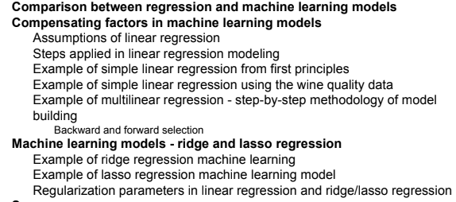
Parallelism of Statistics and Machine Learning

Slide 3
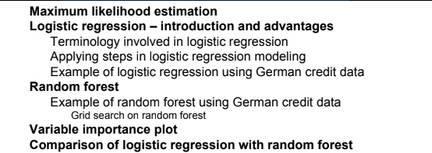
Logistic Regression Versus Random Forest

Slide 4
Comparison between regression and
Machine Learning models
Linear regression and machine learning models both try to solve the same problem in different ways.
Consider a simple example of a two-variable equation fitting the best possible plane,
Regression models - It tries to fit the best possible hyperplane by minimizing the errors between the hyperplane and actual observations.
Machine learning, - The same problem has been converted into an optimization problem in which errors are modeled in squared form to minimize errors by altering the weights.

Slide 5
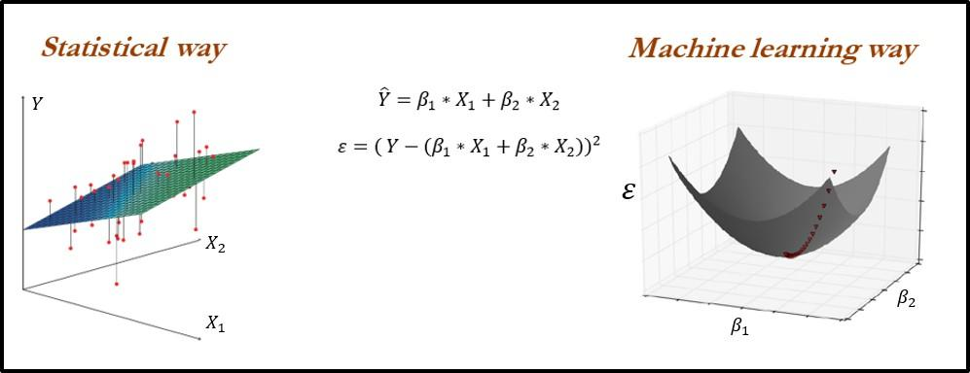
Comparison between Regression and
Machine Learning models
In statistical modeling, samples are drawn from the population and the model will be fitted on sampled data.
However, in machine learning, even small numbers such as 30 observations would be good enough to update the weights at the end of each iteration

Slide 6
Comparison between Regression and
Machine Learning models
Statistical models are parametric in nature, which means a model will have parameters on which diagnostics are performed to check the validity of the model.
Whereas machine learning models are non-parametric, do not have any parameters, or curve assumptions; these models learn by themselves based on provided data and come up with complex and intricate functions rather than predefined function fitting.
Multi-collinearity checks are required to be performed in statistical modeling.
Whereas, in machine learning space, weights automatically get adjusted to compensate the multicollinearity problem.
Note : Multicollinearity occurs when two or more independent variables are highly correlated with one another in a regression model. This means that an independent variable can be predicted from another independent variable in a regression model.

Slide 7
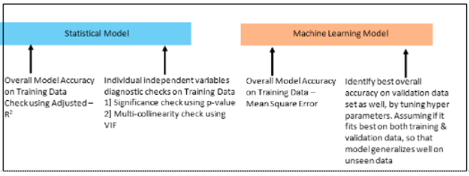
Compensating Factors In Machine Learning Model

Slide 8
Compensating Factors In Machine Learning Model
Statistical model
The two-point validation is performed on the statistical modeling methodology on training data
overall model accuracy
individual parameters significance test.
Machine Learning Model
On top, statistical diagnostics on individual variables are not performed in machine learning.
In machine learning, data will be split into three parts (train data - 50 percent, validation data - 25 percent, testing data - 25 percent) rather than two parts in statistical methodology.
Machine learning models should be developed on training data, and its hyperparameters should be tuned based on validation data to ensure the two-point validation equivalence.
Thus the robustness of models is ensured without diagnostics performed at an individual variable level.

Slide 9
Assumptions of linear regression
Linear regression has the following assumptions, failing which the linear regression model does not hold true:
The dependent variable should be a linear combination of independent variables
No autocorrelation in error terms
Errors should have zero mean and be normally distributed
No or little multi-collinearity
Error terms should be homoscedastic

Slide 10

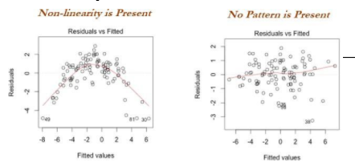
Assumptions of linear regression
The dependent variable should be a linear combination of independent variables:
Y should be a linear combination of X variables. Please note, in the following equation, X2 has raised to the power of 2, the equation is still holding the assumption of a linear combination of variables:

Slide 11
Assumptions of linear regression
In the preceding sample graph, initially, linear regression was applied and the errors seem to have a pattern rather than being pure white noise; in this case, it is simply showing the presence of non-linearity.
After increasing the power of the polynomial value, now the errors simply look like white noise.

Slide 12
Assumptions of linear regression
No autocorrelation in error terms:
Presence of correlation in error terms penalized model accuracy.
How to diagnose:
Durbin-Watson's d tests the null hypothesis that the residuals are not linearly auto correlated.
While d can lie between 0 and 4,
if d ≈ 2 indicates no autocorrelation,
0<d<2 implies positive autocorrelation
2<d<4 indicates negative autocorrelation.

Slide 13
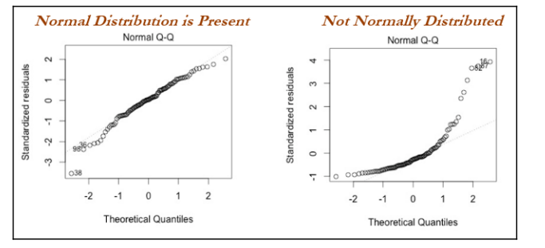
Assumptions of linear regression
Error should have zero mean and be normally distributed:
Errors should have zero mean for the model to create an unbiased estimate.
Plotting the errors will show the distribution of errors.
If error terms are not normally distributed, it implies confidence intervals will become too wide or narrow, which leads to difficulty in estimating coefficients based on minimization of least squares:

Slide 14
Assumptions of linear regression
How to diagnose:
Q-Q plot and Kolmogorov-Smirnov tests will be helpful.
By looking into the above Q-Q plot, it is evidentthat the first chart shows errors are normally distributed, as the residuals do not seem to be deviating much compared with the diagonal-like line,
In the right-hand chart, it is clearly showing that errors are not normally distributed;
In these scenarios, we need to reevaluate the variables by taking log transformations and so on to make residuals look as they do on the left-hand chart.

Slide 15

Assumptions of linear regression
No or little multi-collinearity:
Multi-collinearity is the case in which independent variables are correlated with each other and this situation creates unstable models by inflating the magnitude of coefficients/estimates.
It also becomes difficult to determine which variable is contributing to predict the response variable.
VIF is calculated for each independent variable by calculating the R-squared value with respect to all the other independent variables and tries to eliminate which variable has the highest VIF value one by one:
Variance inflation factor (VIF). If VIF <= 4 suggests no multi-collinearity, in banking scenarios, people use VIF <= 2

Slide 16
Assumptions of linear regression
Errors should be homoscedastic:
Errors should have constant variance with respect to the independent variable, which leads to impractically wide or narrow confidence intervals for estimates, which degrades the model's performance.
One reason for not holding homoscedasticity is due to the presence of outliers in the data, which drags the model fit toward them with higher weights

Slide 17
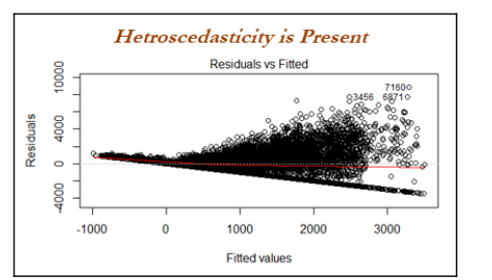
Assumptions of linear regression
How to diagnose:
Look into the residual versus dependent variables plot;
if any pattern of cone or divergence does exist, it indicates the errors do not have constant variance, which impacts its predictions.

Slide 18
Steps applied in linear regression modeling
Steps applied in linear regression modeling
The following steps are applied in linear regression modeling in industry:
1. Missing value and outlier treatment
2. Correlation check of independent variables
3. Train and test random classification
4. Fit the model on train data
5. Evaluate model on test data

Slide 19
Example of simple linear regression from first principles
UCI machine learning repository at https://archive.ics.uci.edu/ml/datasets/Wine+Quality.
Simple linear regression is a straightforward approach for predicting the dependent/response variable Y given the independent/predictor variable X. It assumes a linear relationship between X and Y
β0 and β1 are two unknown constants which are intercept and slope parameters respectively. Once we determine the constants, we can utilize them for the prediction of the dependent variable
Residuals are the differences between the ith observed response value and the ith response value that is predicted from the model. Residual sum of squares is shown. The least squares approach chooses estimates by minimizing errors

Slide 20
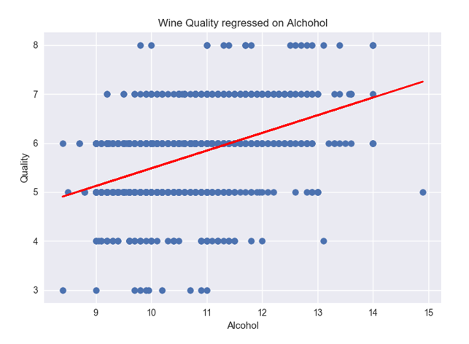
Example of simple linear regression from first principles

Slide 21
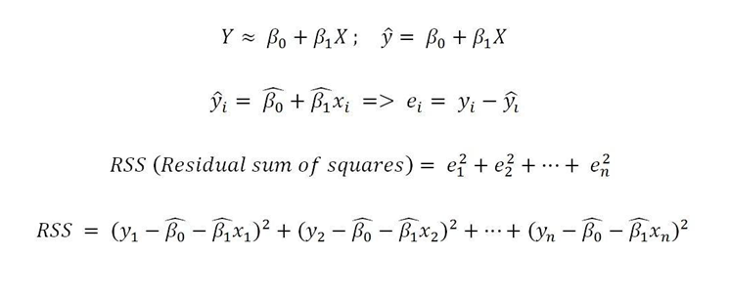
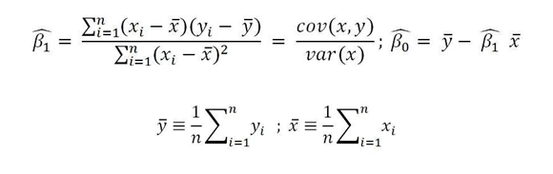
Example of simple linear regression from first principles

Slide 22
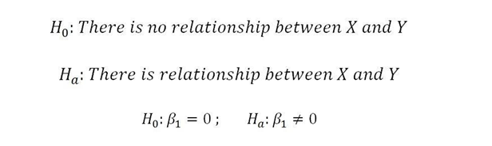
Example of simple linear regression from first principles
In order to prove statistically that linear regression is significant, we have to perform hypothesis testing.
Let's assume we start with the null hypothesis that there is no significant relationship between X and Y
Since, if β1 = 0, then the model shows no association between both variables (Y = β0 + ε), these are the null hypothesis assumptions;
In order to prove this assumption right or wrong, we need to determine β1 is sufficiently far from 0 so that we can be confident that β1 is nonzero and have a significant relationship between both variables

Slide 23
Example of simple linear regression from first principles
It depends on the distribution of β1, which is its mean and standard error (similar to standard deviation).
In some cases, if the standard error is small, even relatively small values may provide strong evidence that β1 ≠ 0, hence there is a relationship between X and Y.
In contrast, if SE(β1) is large, then β1 must be large in absolute value in order for us to reject the null hypothesis.

Slide 24

Example of simple linear regression from first principles
We usually perform the t test to check how many standard deviations β1 is away from the value 0:
With this t value, we calculate the probability of observing any value equal to |t| or larger, assuming β1 = 0; this probability is also known as the p-value.
If p-value < 0.05, it signifies that β1 is significantly far from 0, hence we can reject the null hypothesis and agree that there exists a strong relationship
if p-value > 0.05, we accept the null hypothesis and conclude that there is no significant relationship between both variables

Slide 25

Example of simple linear regression from first principles
To predict the dependent value and check for the R-squared value;
if the value is >= 0.7, it means the model is good enough to deploy on unseen data
if it is not such a good value (<0.6), we can conclude that this model is not good enough to deploy

Slide 26

Machine learning models - ridge and lasso regression
In linear regression, only the residual sum of squares (RSS) is minimized
In ridge and lasso regression, a penalty is applied (also known as shrinkage penalty) on coefficient values to regularize the coefficients with the tuning parameter λ
When λ=0, the penalty has no impact, ridge/lasso produces the same result as linear regression, whereas λ -> ∞ will bring coefficients to zero

Slide 27
Machine learning models - ridge and lasso regression
Lagrangian multipliers
Defintion of Lagrangian : a function that describes the state of a dynamic system in terms of position coordinates and their time derivatives
The Lagrange multiplier, λ, measures the increase in the objective function (f(x, y) that is obtained through a marginal relaxation in the constraint (an increase in k). For this reason, the Lagrange multiplier is often termed a shadow price.
The method of Lagrange multipliers in Machine learning is a simple and elegant method of finding the local minima or local maxima of a function subject to equality or inequality constraints. Lagrange multipliers are also called undetermined multipliers.

Slide 28


Machine learning models - ridge and lasso regression
Lagrangian multipliers
The objective is RSS subjected to cost constraint (s) of budget.
For every value of λ, there is an s such that will provide the equivalent equations, as shown for the overall objective function with a penalty factor

Slide 29
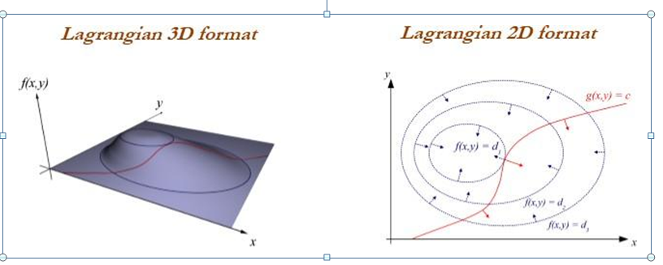
Machine learning models - ridge and lasso regression

Slide 30
Machine learning models - ridge and lasso regression
For any fixed value of λ, ridge regression only fits a single model and the model-fitting procedure can be performed very quickly
One disadvantage of ridge regression
Given a situation where the number of predictors is significantly large, using ridge may provide accuracy, but it includes all the variables, which is not desired in a compact representation of the model;
But in lasso, it will set the weights of unnecessary variables to zero

Slide 31
Machine learning models - ridge and lasso regression
What is Ridge Regression?
Ridge regression is a model tuning method that is used to analyse any data that suffers from multicollinearity. This method performs L2 regularization. When the issue of multicollinearity occurs, least-squares are unbiased, and variances are large, this results in predicted values being far away from the actual values.
The cost function for ridge regression:
Min(||Y – X(theta)||^2 + λ||theta||^2)
Lambda is the penalty term. λ given here is denoted by an alpha parameter in the ridge function. So, by changing the values of alpha, we are controlling the penalty term. The higher the values of alpha, the bigger is the penalty and therefore the magnitude of coefficients is reduced.
It shrinks the parameters. Therefore, it is used to prevent multicollinearity
It reduces the model complexity by coefficient shrinkage

Slide 32
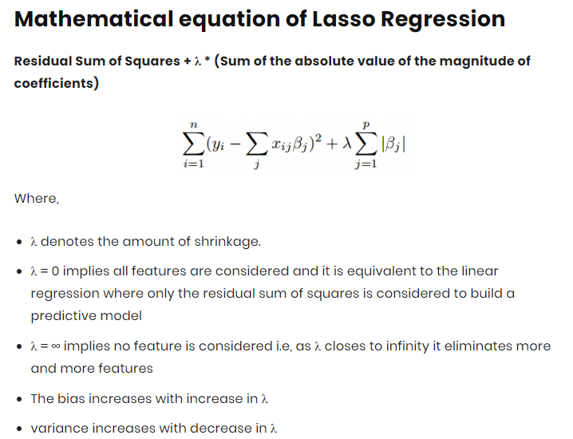
Machine learning models - ridge and lasso regression
Lasso Meaning
The word “LASSO” stands for Least Absolute Shrinkage and Selection Operator. It is a statistical formula for the regularisation of data models and feature selection.
Regularization
Regularization is an important concept that is used to avoid overfitting of the data, especially when the trained and test data are much varying.
Regularization is implemented by adding a “penalty” term to the best fit derived from the trained data, to achieve a lesser variance with the tested data and also restricts the influence of predictor variables over the output variable by compressing their coefficients.

Slide 33
Machine learning models - ridge and lasso regression
The key difference is in how they assign penalty to the coefficients:
Ridge Regression:
Performs L2 regularization, i.e. adds penalty equivalent to square of the magnitude of coefficients
Minimization objective = LS Obj + α * (sum of square of coefficients)
Lasso Regression:
Performs L1 regularization, i.e. adds penalty equivalent to absolute value of the magnitude of coefficients
Minimization objective = LS Obj + α * (sum of absolute value of coefficients)

Slide 34
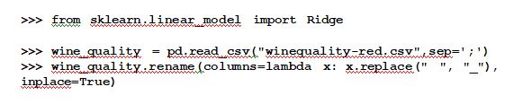
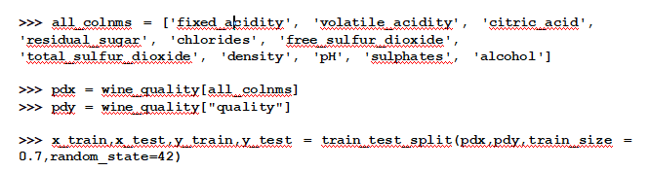
Example of ridge regression machine learning
Ridge regression is a machine learning model in which we do not perform any statistical diagnostics on the independent variables and just utilize the model to fit on test data and check the accuracy of the fit. Here, we have used the scikit-learn package

Slide 35
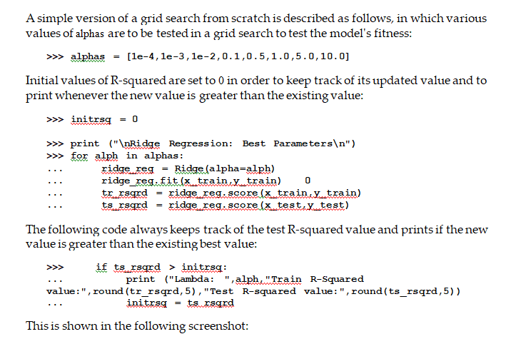
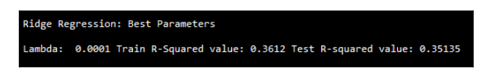
Example of ridge regression machine learning

Slide 36
Example of ridge regression machine learning
Ridge regression is a machine learning model in which we do not perform any statistical diagnostics on the independent variables and just utilize the model to fit on test data and check the accuracy of the fit. Here, we have used the scikit-learn package

Slide 37
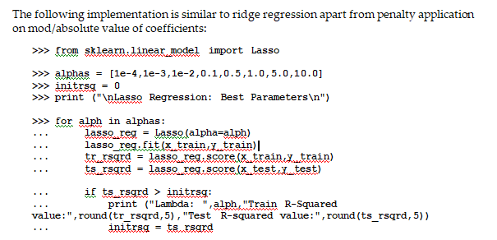
Example of Lasso regression machine learning
Lasso regression is a close cousin of ridge regression, in which absolute values of coefficients are minimized rather than the square of values

Slide 38
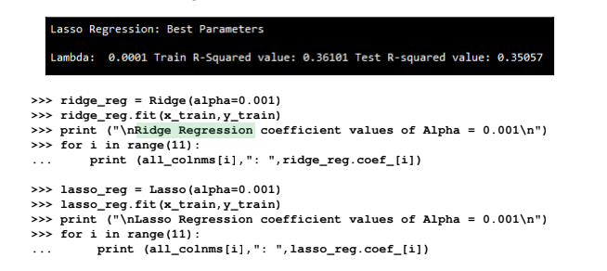
Example of Lasso regression machine learning

Slide 39
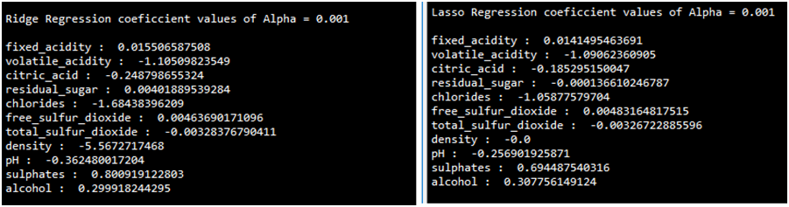
Example of Lasso regression machine learning
The following results show the coefficient values of both methods; the coefficient of density has been set to 0 in lasso regression, whereas the density value is -5.5672 in ridge regression; also, none of the coefficients in ridge regression are zero values:

Slide 40
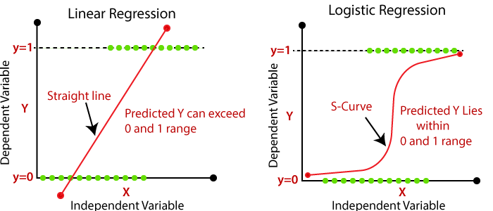
Logistic Regression
Logistic regression is a process of modeling the probability of a discrete outcome given an input variable.
It is used in statistical software to understand the relationship between the dependent variable and one or more independent variables by estimating probabilities using a logistic regression equation. This type of analysis can help you predict the likelihood of an event happening or a choice being made.

Slide 41
Maximum Likelihood
Maximum likelihood estimation is a method of estimating the parameters of a model given observations, by finding the parameter values that maximize the likelihood of making the observations, this means finding parameters that maximize the probability p of event 1 and (1-p) of non-event 0
probability (event + non-event) = 1

Slide 42
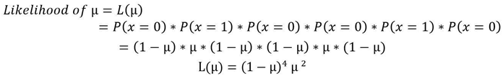

Maximum Likelihood
Example: Sample (0, 1, 0, 0, 1, 0) is drawn from binomial distribution. What is the maximum likelihood estimate of µ?
For binomial distribution P(X=1) = µ and P(X=0) = 1- µ where µ is the parameter:
log is applied to both sides of the equation for mathematical convenience; also, maximizing likelihood is the same as the maximizing log of likelihood

Slide 43
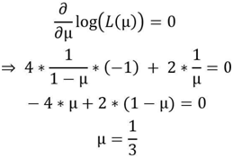
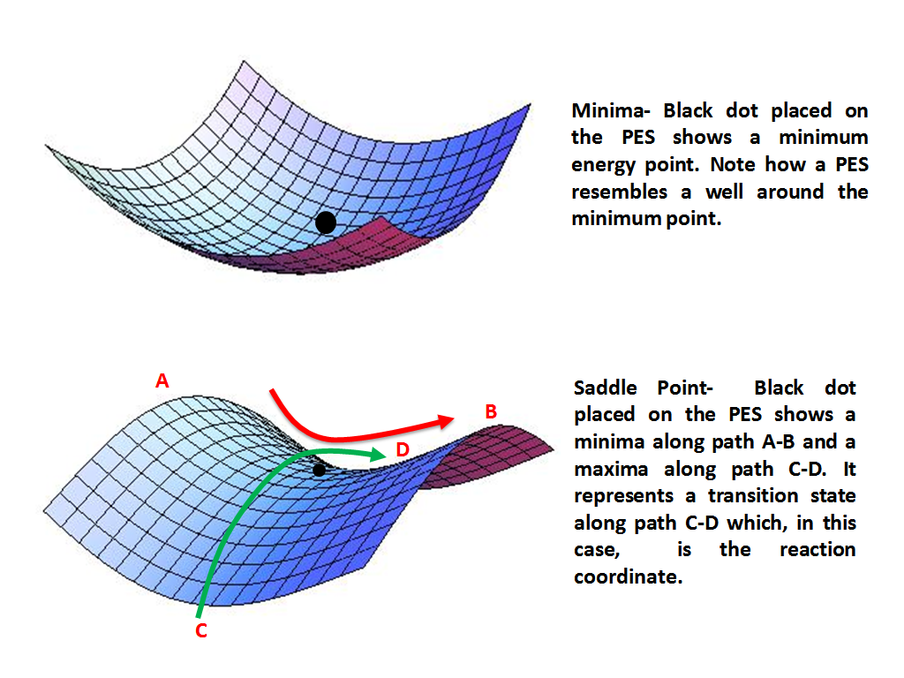

Maximum Likelihood
Determining the maximum value of µ by equating derivative to zero
Do double differentiation to determine the saddle point obtained from equating derivative to zero is maximum or minimum.
If the µ value is maximum; double differentiation of log(L(µ)) should be a negative value

Slide 44

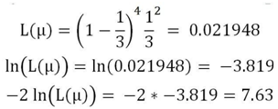
Maximum Likelihood
Even without substitution of µ value in double differentiation, we can determine that it is a negative value, as denominator values are squared and it has a negative sign against both terms. Nonetheless, we are substituting and the value is
it has been proven that at value µ = 1/3, it is maximizing the likelihood. If we substitute the value in the log likelihood function, we will obtain:
So, logistic regression tries to find the parameters by maximizing the likelihood with respect to individual parameters

Slide 45
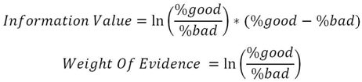
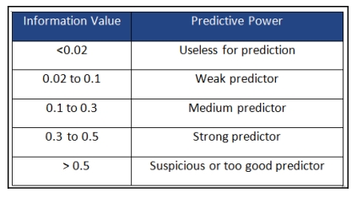
Terminology involved in Logistic regression
Information value (IV)
This is very useful in the preliminary filtering of variables prior to including them in the model.
IV is mainly used by industry for eliminating major variables in the first step prior to fitting the model, as the number of variables present in the final model would be about 10.
Hence, initial processing is needed to reduce variables from 400+ in number or so

Slide 46
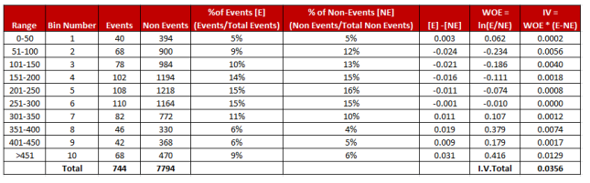
Terminology involved in Logistic regression
Example: In the following table, continuous variable (price) has been broken down into deciles (10 bins) based on price range and the counted number of events and non-events in that bin, and the information value has been calculated for all the segments and added together. We got the total value as 0.0356, meaning it is a weak predictor to classify events.

Slide 47
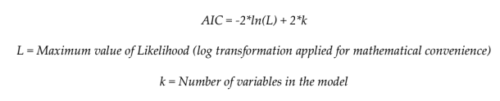
Terminology involved in Logistic regression
Akaike information criteria (AIC):
The Akaike information criterion (AIC) is a mathematical method for evaluating how well a model fits the data it was generated from. In statistics, AIC is used to compare different possible models and determine which one is the best fit for the data.
This measures the relative quality of a statistical model for a given set of data.
During a comparison between two models, the model with less AIC is preferred over higher value

Slide 48
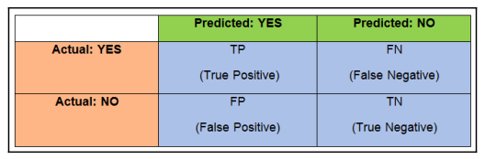
Terminology involved in Logistic regression
Receiver operating characteristic (ROC) curve:
This is a graphical plot that illustrates the performance of a binary classifier as its discriminant threshold is varied.
The curve is created by plotting true positive rate (TPR) against false positive rate (FPR) at various threshold values.
A threshold is a real value between 0 and 1, used to convert the predicted probability of output into class.
Ideally, the threshold should be set in a way that trade-offs value between both categories and produces higher overall accuracy
Optimum threshold = Threshold where maximum (sensitivity + speciﬁcity) is possible
Confuion Matrix

Slide 49
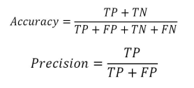
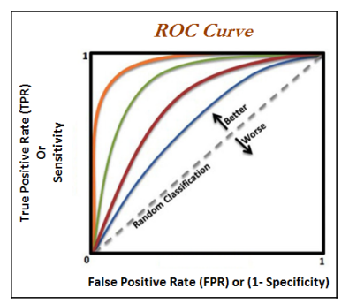
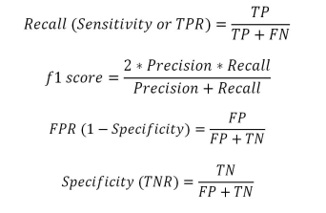
Terminology involved in Logistic regression

Slide 50
Terminology involved in Logistic regression
Rank ordering: After sorting observations in descending order by predicted probabilities, deciles are created (10 equal bins with 10 percent of total observations in each bin). By adding up the number of events in each decile, we will get aggregated events for each decile and this number should be in decreasing order, else it will be in serious violation of logistic regression methodology
Concordance/c-statistic: The C-statistic (sometimes called the “concordance” statistic or C-index) is a measure of goodness of fit for binary outcomes in a logistic regression model.This is a measure of quality of fit for a binary outcome in a logistic regression model. It is a proportion of pairs in which the predicted event probability is higher for the actual event than non-event

Slide 51
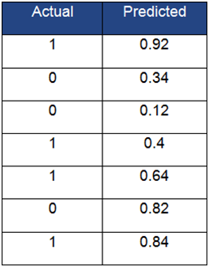
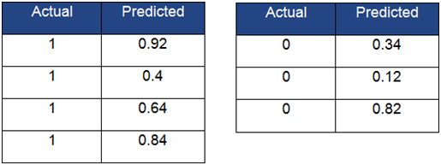
Terminology involved in Logistic regression
In the following table, both actual and predicted values are shown with a sample of seven rows. Actual is the true category, either default or not; whereas predicted is predicted probabilities from the logistic regression model. Calculate the concordance value
For calculating concordance, we need to split the table into two (each table with actual values as 1 and 0) and apply the Cartesian product of each row from both tables to form pairs

Slide 52
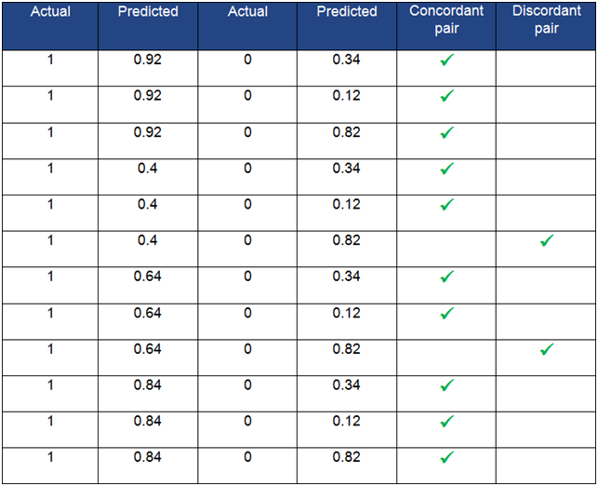
Terminology involved in Logistic regression
The complete Cartesian product has been calculated and has classified the pair as a concordant pair whenever the predicted probability for 1 category is higher than the predicted probability for 0 category

Slide 53
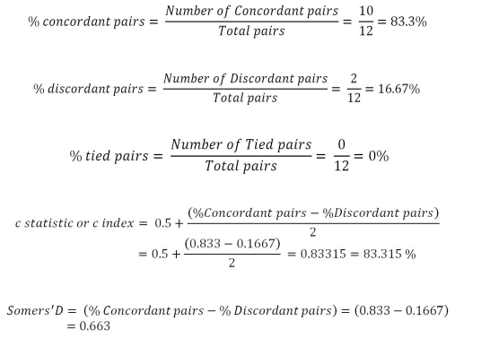
Terminology involved in Logistic regression

Slide 54
Terminology involved in Logistic regression
C-statistic: This is 0.83315 percent or 83.315 percent, and any value greater than 0.7 percent or 70 percent is considered a good model to use for practical purposes
Divergence: The distance between the average score of default accounts and the average score of non-default accounts. The greater the distance, the more effective the scoring system is at segregating good and bad observations.
K-S statistic: This is the maximum distance between two population distributions. It helps with discriminating default accounts from non-default accounts

Slide 55
Terminology involved in Logistic regression
Population stability index (PSI): This is the metric used to check that drift in the current population on which the credit scoring model will be used is the same as the population with respective to development time:
PSI <= 0.1: This states no change in characteristics of the current population with respect to the development population
0.1 < PSI <= 0.25: This signifies some change has taken place and warns for attention, but can still be used
PSI >0.25: This indicates a large shift in the score distribution of the current population compared with development time

Slide 56
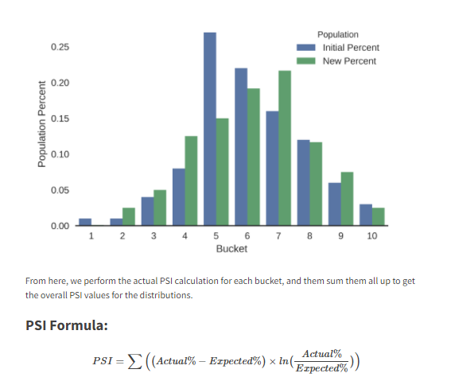
Terminology involved in Logistic regression
To calculate the PSI we first divide the initial population range into 10 buckets (an arbitrary number I chose), and count the number of values in each of those buckets for the initial and new populations, and then divide those by the total values in each population to get the percents in each bucket. As expected, plotting the percents ends up looking like a discretized version of the original chart:

Slide 57
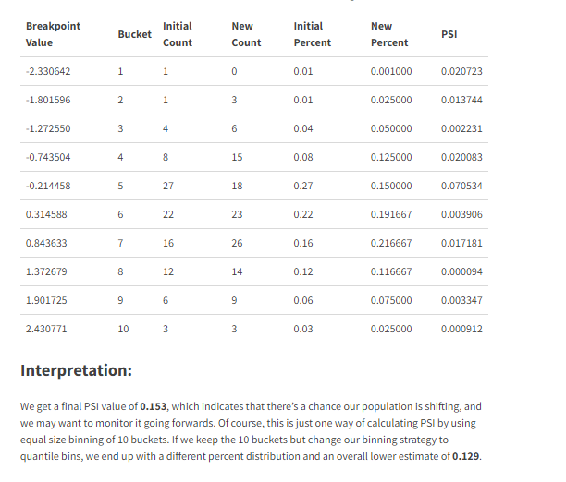
Terminology involved in Logistic regression

Slide 58
Applying steps in logistic regression modeling
The following steps are applied in linear regression modeling in industry:
1. Exclusion criteria and good-bad definition finalization
2. Initial data preparation and univariate analysis
3. Derived/dummy variable creation
4. Fine classing and coarse classing
5. Fitting the logistic model on the training data
6. Evaluating the model on test data

Slide 59
Random forest
Random Forest is a popular machine learning algorithm that belongs to the supervised learning technique.
It can be used for both Classification and Regression problems in ML.
It is based on the concept of ensemble learning, which is a process of combining multiple classifiers to solve a complex problem and to improve the performance of the model
Random Forest is a classifier that contains a number of decision trees on various subsets of the given dataset and takes the average to improve the predictive accuracy of that dataset.
Instead of relying on one decision tree, the random forest takes the prediction from each tree and based on the majority votes of predictions, and it predicts the final output.
The greater number of trees in the forest leads to higher accuracy and prevents the problem of overfitting.

Slide 60
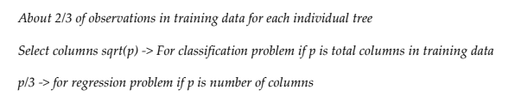
Random forest
RF focuses on sampling both observations and variables of training data to develop independent decision trees and take majority voting for classification and averaging for regression problems respectively
In contrast, bagging samples only observations at random and selects all columns that have the deficiency of representing significant variables at root for all decision trees.
This way makes trees that are dependent on each other, for which accuracy will be penalized.
The following are a few rules of thumb when selecting sub-samples from observations using random forest

Slide 61
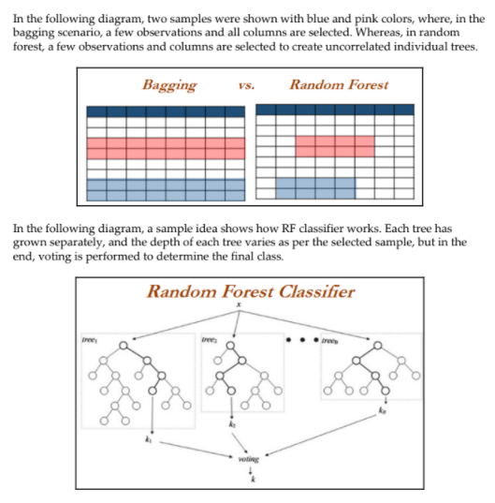
Random forest

Slide 62
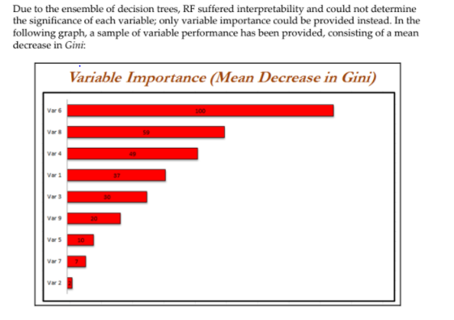
Random forest

Slide 63
Example of random forest using German credit data
The same German credit data is being utilized to illustrate the random forest model
A very significant difference anyone can observe compared with logistic regression is that effort applied on data preprocessing drastically decreases.
In RF, we have not removed variables one by one from analysis based on significance and VIF values, as significance tests are not applicable for ML models. However five-fold cross validation has been performed on training data to ensure the model's robustness
In RF we have not removed the extra dummy variable from the analysis, as the latter automatically takes care of multi-collinearity.
Random forest requires much less human effort and intervention to train the model.

Slide 64
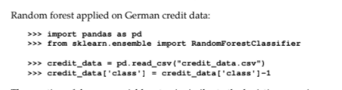
Example of random forest using German credit data

Slide 65
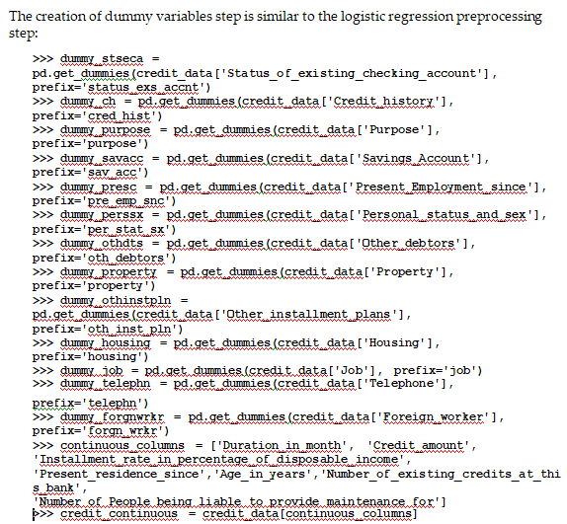

Example of random forest using German credit data

Slide 66
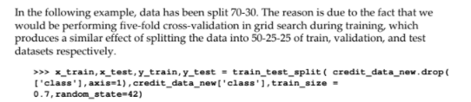
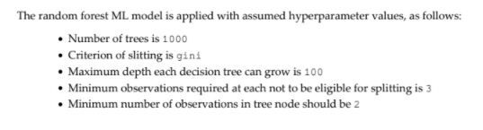
Example of random forest using German credit data

Slide 67
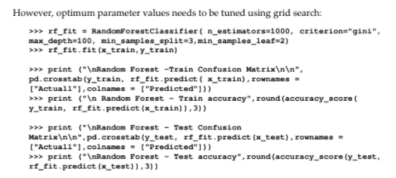
Example of random forest using German credit data

Slide 68
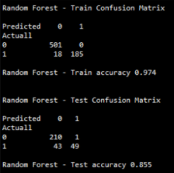
Example of random forest using German credit data
The test accuracy produced from random forest is 0.855,

Slide 69
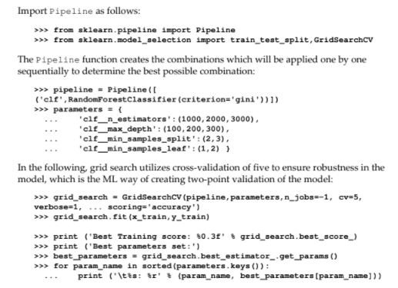
Grid search on Random Forest
Grid search has been performed by changing various hyperparameters with the following settings. However, readers are encouraged to try other parameters to explore further in this space.
Number of trees is (1000,2000,3000)
Maximum depth is (100,200,300)
Minimum samples per split are (2,3)
Minimum samples in leaf node are (1,2)

Slide 70
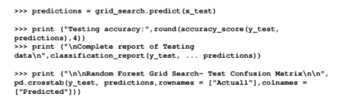

Grid search on Random Forest

Slide 71

Variable importance plot
Variable importance plot provides a list of the most significant variables in descending order by a mean decrease in Gini. The top variables contribute more to the model than the bottom ones and also have high predictive power in classifying default and non-default customers
Grid search does not have variable importance functionality in Python scikit- learn, hence we are using the best parameters from grid search and plotting the variable importance graph with simple random forest scikit-learn function. Whereas, in R programming, we have that provision, hence R code would be compact here:

Slide 72

Comparison of Logistic regression with Random Forest
In the following table, both models explanatory variables have been put in descending order based on the importance of them towards the model contribution.
In the logistic regression model, it is the p-value (minimum is a better predictor), and for random forest it is the mean decrease in Gini (maximum is a better predictor).
Many of the variables are very much matching in importance like, status_exs_accnt_A14, credit_hist_A34, Installment_rate_in_percentage_of_disposable_income, property_A_24, Credit_amount, Duration_in_month

Slide 73
Logistic Regression
Logistic Regression in R
https://www.youtube.com/watch?v=Z5WKQr4H4Xk
Logistic Regression in Python
https://www.youtube.com/watch?v=jHMjpBxKRck

Slide 74
Logistic Regression
Logistic Regression Versus Random Forest-Maximum likelihood estimation
https://www.youtube.com/watch?v=75e1RjrxSI4
Logistic Regression
https://www.youtube.com/watch?v=emHDSX6R6eg
Logistic Regression in R
https://www.youtube.com/watch?v=Z5WKQr4H4Xk

